Slide 1
CUSTOMER BILLING SYSTEM
BY
NASIR-RA2111052010027
RUTHWIK-RA2111052010031
UNDER THE GUIDENCE OF
HEMA MAM(PPS DEPT)

Slide 2
INTRODUCTION:
THIS PROJECT IS BASED ON BILLING SYSTEM IN SHOPPING MALLS.
CUSTOMER BILLING SYSTEM PROJECT IS A SIMPLE CONSOLE APPLICATION DESIGNED TO DEMONSTRATE THE PRACTICAL USE OF C PROGRAMMING LANGUAGE AND ITS FEATURES AS WELLS AS TO GENERATE AN APPLICATION WHICH CAN BE USED IN ANY DEPARTMENTAL STORE, SHOPS, CAFES ETC. FOR BILLING TO THE CUSTOMER.
YOU CAN USE THIS APPLICATION TO KEEP THE RECORDS SUCH AS NAME, ADDRESS, MOBILE NUMBER, PAID AMOUNT, DUE AMOUNT, PAYMENT DATE ETC. OF YOUR REGULAR COSTUMER. MOREOVER, IF YOU HAVE A NEW CUSTOMER, YOU CAN ADD AND EDIT THE ACCOUNT AT ANY TIME.

Slide 3
About this billing system:
YOU CAN USE THIS APPLICATION TO KEEP THE RECORDS SUCH AS NAME OF THE CUSTOMER ,THEIR BILLING NUMBER,HOW MUCH DISCOUNT THEY OFFERED ETC.
AND THIS PROGRAM IS WRITTEN IN C-LANGUAGE IN THE BASIS OF IF ELSE …….IF ELSE STATEMENTS……

Slide 4
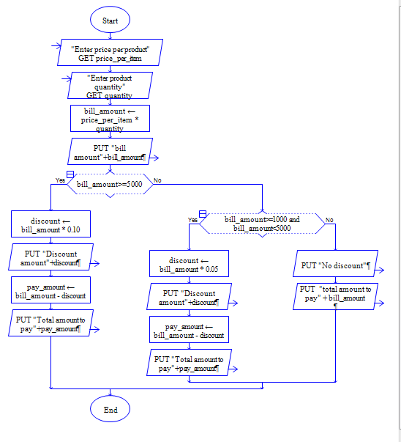

Slide 5
USES OF HIS CUSTOMER BILLING SYSTEM:
Customer Billing System Project is a simple console application designed to demonstrate the practical use of C programming language and its features as wells as to generate an application which can be used in any departmental store, shops, cafes etc. for billing to the customer.

Slide 6
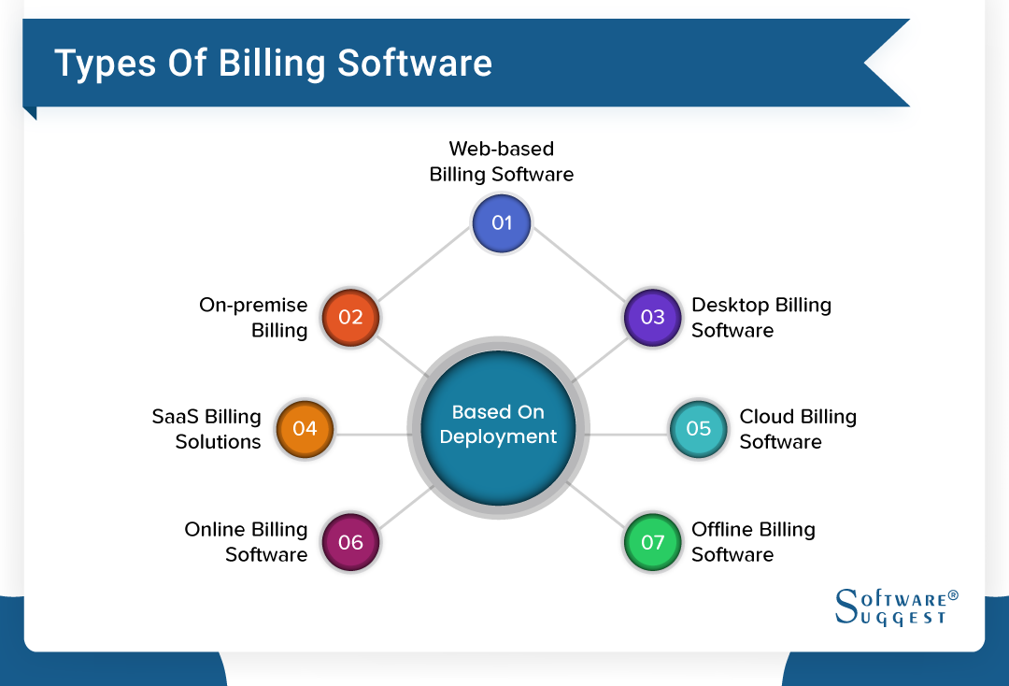

Slide 7
AND WE ARE DOING A PROGRAM BASED ON ONLINE BILLING SOFTWARE………..THANK YOU

Slide 8
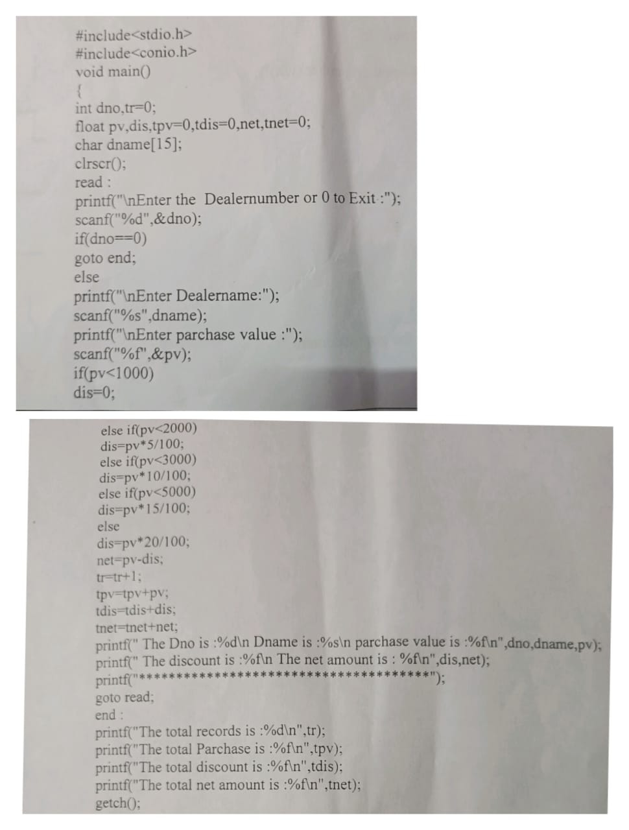
Code based on customer billing system

Slide 9
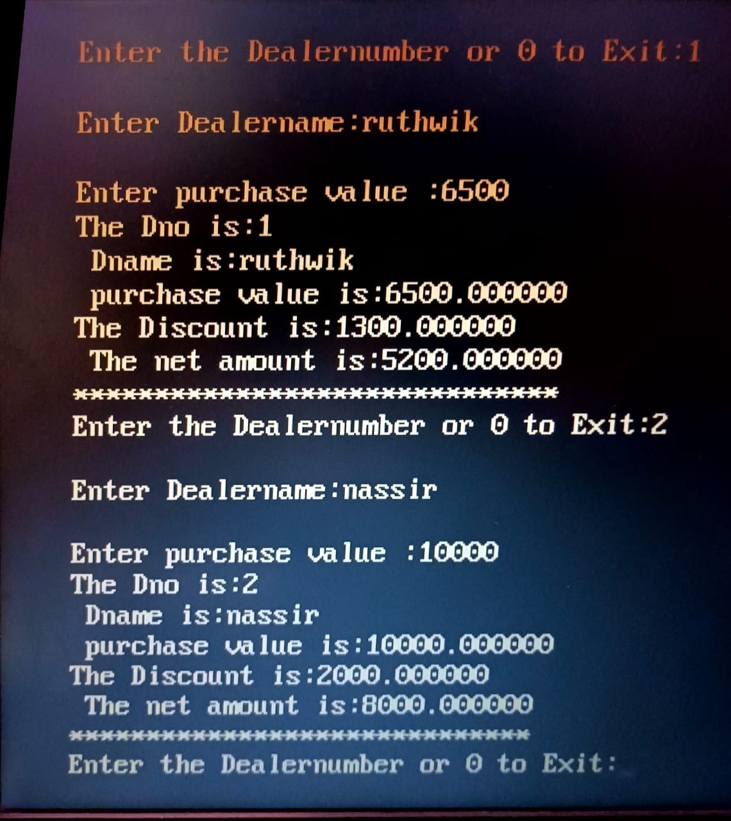
Out put of the code

Slide 10
In this project me and nasir contributed equal share……..
He contributed with project details and code errors.
And me contributed in creating ppt and preparation for code …this leads to ‘0’ errors .
On the behalf of this project we want to thank our Hema mam…who teached C to us ……

Slide 11
THANK YOU

